Slide 1
CS 4530
Fundamentals of Software Engineering
Module 16: Refactoring and Technical Debt
Jonathan Bell, Adeel Bhutta, Mitch Wand
Khoury College of Computer Sciences
© 2022 Released under the CC BY-SA license

Slide 2
Learning Goals
By the end of this lesson, you should be able to…
Define “refactoring” and give examples.
Explain how refactoring fits into an agile development process and help reduce technical debt
Define “technical debt”
Suggest when it may be appropriate to accrue technical debt and when it may be appropriate to retire it.

Slide 3
Let’s discuss Refactoring first

Slide 4
Refactoring
Refactoring is the process of applying transformations (refactorings) to a program, and the internal structure of the system is improved
Goals:
keep program readable, understandable, and maintainable
by eliminating small problems soon, you can avoid big troubles later
Characteristics:
behavior-preserving: make sure the program works after each step
small steps
Notes:
The process of changing the source code of a software system such that:
The external (observable) behavior of the system does not change - e.g., functional requirements are maintained
But the internal structure of the system is improved

Slide 5
Example Refactoring
Introduce Parameter and Extract optional Parameter
Original Code
function greeter (firstName : String, lastName : String) { return "Hello, " + firstName + " " + lastName;
}
document.body.innerHTML = greeter("Jane","User");
Refactored Code # 1
function greeter (firstName : String, lastName : String, greeting = "Hello, ") {
return greeting + firstName + " " + lastName;
}
document.body.innerHTML = greeter("Jane","User");
Refactored Code # 2
function greeter (firstName : String, lastName : String, greeting : String) {
return greeting + firstName + " " + lastName;
}
document.body.innerHTML = greeter("Jane","User“,"Hello, ");
Notes:
Refactoring is a fancy name for a (usually-simple) program transformation. A refactoring rearranges code, but does not (or should not) change its behavior.
Here is a simple example: removing a hardcoded string as introducing it as parameter. This is an optional parameter in first version of refactoring. In the next version, we could make that a required parameter
More examples at
https://www.jetbrains.com/help/webstorm/specific-typescript-refactorings.html#typescript_extract_parameter

Slide 6

Martin Fowler is the “father” of refactoring
“Any fool can write code that a computer can understand. Good programmers write code that humans can understand.”
Notes:
Martin Fowler is the author of many works on software engineering methodology, including the original text on refactoring. Not inventor of refactoring by any means, but an evangelist for refactoring and related development methodologies

Slide 7

Fowler’s book
presents a catalogue of refactorings, similar to the catalogue of design patterns in the GoF book
Gave names to each transformation
Helpful for team communication
Identified and named “bad smells” (indications that refactoring may be needed)
Discusses when and how to apply refactorings
many of Fowler’s refactorings are the inverse of another refactoring
often there is not a unique “best” solution
discussion of the tradeoffs
Notes:
also in the book:
UML diagrams to illustrate the situation before and after
examples of code before and after each refactoring

Slide 8
Fowler gave colorful names to many of the “code smells” he identified
A complete list (with links to book!)
Mysterious Name
Duplicated Code
Long Function
Long Parameter List
Global Data
Mutable Data
Divergent Change
Shotgun Surgery
Feature Envy
Data Clumps
Primitive Obsession
Repeated Switches
Loops
Lazy Element
Speculative Generality
Temporary Field
Message Chains
Middle Man
Insider Trading
Large Class
Alternative Classes with Different Interfaces
Data Class
Refused Bequest
“Refactoring: Improving the Design of Existing Code,” Martin Fowler, 1992
Notes:
‘Code’ smells is a fancy name for small mistakes or code patterns that are good candidates for refactoring. Here is a list of Fowler’s named code smells. The powerpoint contains live links to the definitions in the book.

Slide 9
The most common refactoring is renaming
Rename Function (124) (to rename a function)
Rename Variable (137)
Rename Field (244).
People are often afraid to rename things, thinking it’s not worth the trouble, but a good name can save hours of puzzled incomprehension in the future.
Renaming is not just an exercise in changing names. When you can’t think of a good name for something, it’s often a sign of a deeper design malaise. Puzzling over a tricky name leads to significant improvements to your code
“Refactoring: Improving the Design of Existing Code,” Martin Fowler, 1992
Notes:
It is widely believed that naming is one of the two hardest things in programming. So, perhaps the most common refactorings we do are the renameings: Change Function Declaration (124) (to rename a function), Rename Variable (137), and Rename Field (244). People are often afraid to rename things, thinking it’s not worth the trouble, but a good name can save hours of puzzled incomprehension in the future.
Renaming is not just an exercise in changing names. When you can’t think of a good name for something, it’s often a sign of a deeper design malaise. (For example, names like MartianCounterHelper– what does that mean?) Puzzling over a tricky name often leads to significant improvements to your code.

Slide 10


Luckily, VSC automates this and many other common transformations
Notes:
Many IDEs will automate this and other common transformations.

Slide 11
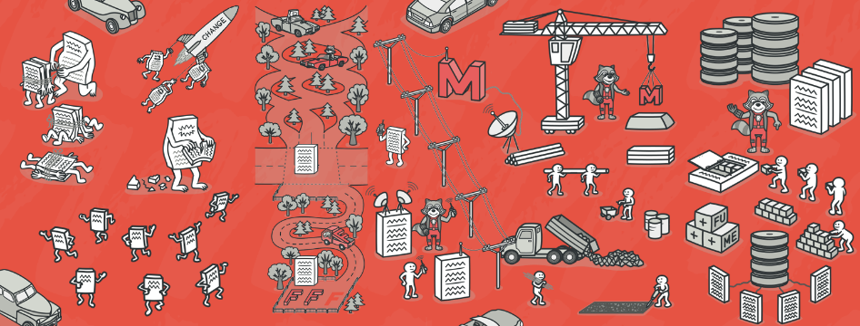
“Local” Refactorings
https://refactoring.guru/
Rename | rename variables, fields methods, classes, packages provide better intuition for the renamed element’s purpose
Extract Method | extract statements into a new method enables reuse; avoid cut-and-paste programming improve readability
Inline Method | replace a method call with the method’s body often useful as intermediate step
Extract Local | introduce a new local variable for a designated expression
Inline Local | replace a local variable with the expression that defines its value
Change Method Signature | reorder a method’s parameters
Encapsulate Field | introduce getter/setter methods
Convert Local Variable to Field | convert local variable to field sometimes useful to enable application of Extract Method
Notes:
some examples of widely used refactorings that are “local” in scope
useful for restructuring methods
We already talked about bad names and duplicate code. We would fix these smells by applying refactoring rename and extract method, resp
Inline method is inverse: when you want to go fold a method back into another
Extract local variable is like extract method, but what you might do with just an expression, so that a big expression can be more manageable
Again, inline local is the inverse: eliminating a local variable that is maybe superfluous
Change function declaration lets us adapt the order of parameters on a method
encapsulate a field replaces direct field accesses with getters/setters, and
Convert local to field creates a field with the specified scope to replace a local variable.
These are just a few of the hundreds of refactorings in Fowler’s book

Slide 12
Type-Related Refactorings
Generalize Declared Type | replace the type of a declaration with a more general type
Extract Interface | create a new interface, and update declarations to use it where possible
Pull Up Members | move methods and fields to a superclass
Infer Generic Type Arguments | infer type arguments for “raw” uses of generic types
Commonly known as Refactoring by Abstraction
Bad abstraction is worst than duplication (pieces of code that look the same, still represent different concepts).
Use “Rule of Three” – Three strikes and you refactor
https://understandlegacycode.com/blog/refactoring-rule-of-three/
Notes:
refactorings for changing the class hierarchy and/or the types of declarations of variables and fields. This is also known as Refactor by Abstraction
purpose is to make designs more flexible, e.g., by facilitating the introduction of design patterns . Few points to mention, some duplication may be acceptable especially if the code looks the same but represents different concepts. Don’t have to refactor every duplicate line of code. One suggestion would be to use “Rule of 3”, if you see something three times, it should be refactored.
https://understandlegacycode.com/blog/refactoring-rule-of-three/
Way, way more refactoring than this. Again, over a hundred. What’s most useful is often what’s automated…

Slide 13

Why Refactor?
New or anticipated requirements require a different design
Altered design will make testing easier
Altered design will improve maintainability
Fix sloppiness by programmers
Retire or avoid technical debt
Notes:
We’ve talked about what refactorings are. But why would you want to refactor?

Slide 14
When to refactor?
Refactoring is incremental redesign
Acknowledge that it will be difficult to get design right the first time
When adding new functionality, fixing a bug, doing code review, or any time
A key part of TDD!
Refactoring evolves design in increments
Refactoring reduces technical debt
What do you refactor?
Notes:
When you add new functionality
Do it before you add the new function, to make it easier to add the function
Or do it after you add the function, to clean up the code including that function
When you need to fix a bug
As you do a code review
Whenever…
The idea behind refactoring is to acknowledge that it will be difficult to get a design right the first time
And as a program’s requirements change, the design may need to change
It is notoriously difficult (impossible?) to design for all possible changes a priori
And as agile programming proponents say, “You aren’t gonna need it” – but what if later you do?
Refactoring provides techniques for evolving the design in small incremental steps
Technical debt: The project’s requirements are constantly changing and at some point it may become obvious that parts of the code are obsolete, have become cumbersome, and must be redesigned to meet new requirements. On the other hand, the project’s programmers are writing new code every day that works with the obsolete parts. Therefore, the longer refactoring is delayed, the more dependent code will have to be reworked in the future.

Slide 15
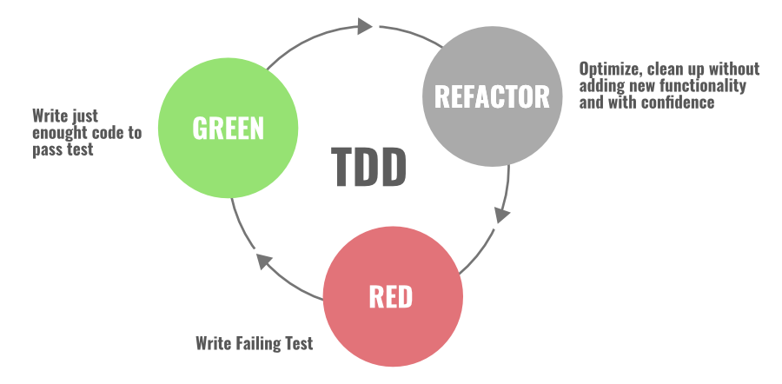
Refactoring with TDD
RED: The first step starts with writing the failing “red-test”. You stop and check what needs to be developed.
Green: In the second step, you write the simplest enough code and get the development pass “green” testing.
Refactor: In the final and third step, you focus on improving and enhancing your code keeping your test green.
Notes:
Red-Green is the most popular and widely used code refactoring technique in the Agile software development process. This technique follows the “test-first” approach to design and implementation, this lays the foundation for all forms of refactoring.

Slide 16


Refactoring Benefits
small incremental steps that preserve program behavior
Regression testing is simplified
most steps are so simple that they can be automated
automation limited in complex cases
refactoring does not always proceed “in a straight line”
sometimes, you want to undo a step you did earlier…
…when you have insights for a better design
Having a name for what you did makes it easier to undo a step
(but of course there’s always git!)
Notes:
Refactoring is a series of small behavior-preserving transformations
Each transformation does little, but a sequence of transformations can produce a significant restructuring
Since each refactoring is small, it's less likely to go wrong
The system is also kept fully working after each small refactoring (via regression testing), reducing the chances that a system can get seriously broken during the restructuring

Slide 17
Refactoring Risks
Developer time is valuable: is this the best use of time today?
Despite best intentions, may not be safe
Potential for version control conflicts
Notes:
If programmers spend time “cleaning up the code”, then that’s less time spent implementing required functionality - and the schedule is slipping as it is!
Refactoring can break code that previously worked

Slide 18
It brings us to Technical Debt

Slide 19

Technical Debt is the Accumulation of Internal Problems in Project Codebase
Internal because they don’t show as user-visible failures.
Examples:
Code Smells;
Missing tests;
Missing documentation;
Dependency on old versions of third-party systems;
Inefficient and/or non-scalable algorithms.
Not just code!

Slide 20
Technical Debts have costs (“interest” on the debt).
Example of Debt
Example of Cost
Code Smells;
Missing tests;
Missing documentation;
Dependency on old versions of third-party systems;
Inefficient and/or non-scalable algorithms.
“Smelly” code is less flexible;
Need to revert breaking change;
Can’t figure out how to use;
May have take over maintenance of old system;
Lose potential customers.

Slide 21
Interest on Technical Debt Accrues over Time
Break even point for cost
Technical Cost
Technical Debt
Time
Invest time to paying off technical debt
=> Refactoring
Notes:
Time plays a big role in technical debt. When it’s introduced, you might get more benefit than the cost that you incur. But, over time, the liability (risk) of that bad technical choice begins to cost you more and more. Eventually, you cross a tipping point, where it is costing you more to maintain this debt than the benefit received. At some point, hopefully, you would decide to pay off the debt.

Slide 22
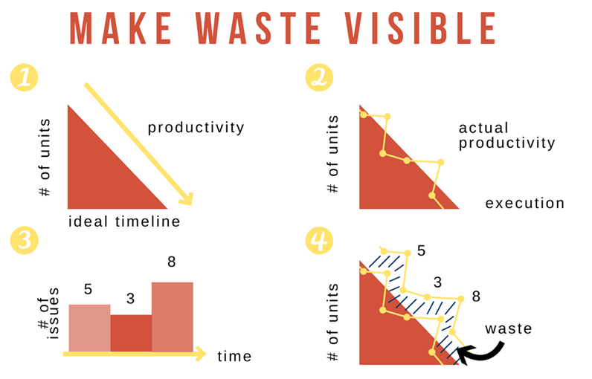
Make Technical Debt Visible
Here are the steps:
Plan the ideal.
Track your Actual.
Track what you spend on waste.
Put it all together
Help stakeholders visualize data (like progress, effect of debt, refactoring)
https://www.scrum.org/resources/blog/making-tech-debt-visible
Notes:
Here are steps:
Plan the ideal.
Track your Actual.
Track what you spend on waste.
Put it all together

Slide 23
Good Reasons to Go Into Technical Debt
Prototyping:
If code will be discarded, or drastically rewritten, don’t waste time perfecting it.
Getting a product out the door:
Time is often crucial in a competitive environment.
Fixing a critical failure:
People are waiting.
Maybe a simple algorithm is good enough:
“Premature optimization is the root of all evil”
Tony Hoare, Donald Knuth

Slide 24
Architectural Technical Debt is Most Expensive
Total cost of ownership generally higher than implementation-level issues; harder to get out of choices of:
Language
Middleware frameworks
Deployment pipeline
Consider: What are the quality attributes that our software needs to ultimately satisfy, and how do these architectural decisions reflect those attributes?
Notes:
Your choices of technology, frameworks, integration, and deployment pipeline will all encapsulate architectural decisions and enable or hinder quality attribute requirements.
Best fix: explicitly allocate time to build and refine the architecture- have an explicit, iterative approach. Allocate that time based on quality attribute requirements. Consider the ways in which the architecture can be adapted to foreseeable changes.
It’s really a requirements problem: what are short-term and long-term goals of the business, and hence, key quality requirements. Are you starting a company that you are hoping will be quickly bought out, and you can cash out? Or does it need to scale up in some way?
(Remember: software engineering is the integral of programming over people and *time*).

Slide 25

The Y2K bug is an example of architectural technical debt
How many digits does it take to store a year?
“I just never imagined anyone would be using these systems 10 years later, let alone 20.”
Philippe Kruchten, Robert Nord, Ipek Ozkaya:
“Managing Technical Debt: Reducing Friction in Software Development”
$24,847.09 in 2022 USD
Notes:
Y2K bug is good example for architectural tech-debt. Storage and RAM SOOOO expensive, can’t we just put off fixing this problem for if it becomes needed?
The key idea is to NOT forget about this problem, but to consider planning around it
Discuss: if you had foreseen this problem, how could you have planned around it?

Slide 26
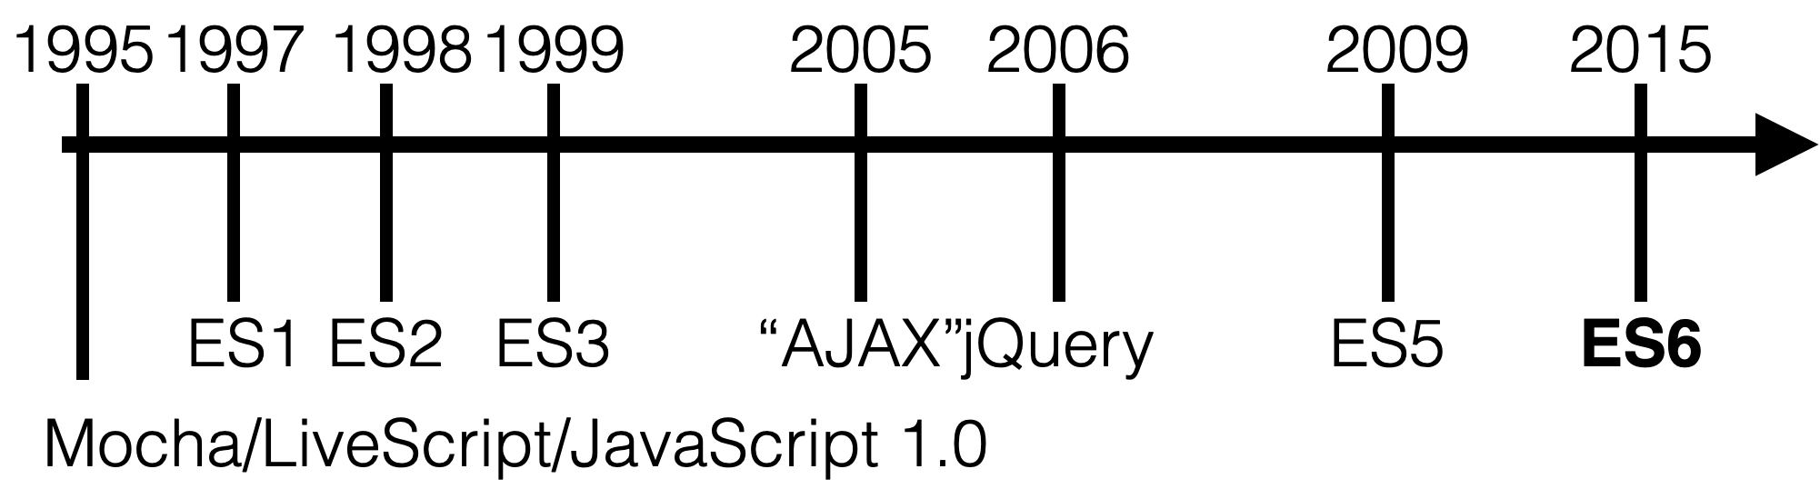
Evolving Languages bring Technical Debt
Classes
Promises
PLUS:
2016: ES7 (Array.includes)
2017: ES8 (Async/Await)
2018: ES9 (rest/spread operator, async iterators)
https://www.fastcompany.com/3028778/why-facebook-invented-a-new-php-derived-language-called-hack
Notes:
Choice of language can cause technical debt, particularly if that language is rapidly evolving.
JS has had a storied past.
ECMA: European Computer Manufacturers Association; technically we are taking about “ECMAScript” not “javascript” but that’s another lecture.
ES5: Minimal update with very little new features
ES6: Added “classes”. Before that, there was no notion of a class in JS. Whoops. ES6 also added promises
(click build) Also technical debt on this slide: since 2015 we have seen 3 new releases of JavaScript, bringing “async await” and many other language features
This also does not represent transitions to TypeScript.
Choosing JS incurs tech debt, because it is basically a given that in a few years the language will have changes, that you will need to learn about, and perhaps adopt to support

Slide 27

Architectural Technical Debt: Facebook
https://www.fastcompany.com/3028778/why-facebook-invented-a-new-php-derived-language-called-hack
Notes:
Facebook was originally written in PHP. They didn’t want to change. So they wrote a new language that closed various gaps in PHP’s design
In 2004 @ Facebook, using a now-popular framework like Ruby on Rails or Django wasn’t an option. Rails’ first public release was a few months later, and Django wasn’t unveiled until the following year. A decade later, PHP’s been widely derided for having a sprawling library of inconsistently named and defined built-in functions, syntax and semantics just different enough from related languages to confuse multilingual programmers, and a history of design decisions that made it easy to write insecure code.

Slide 28

Architectural Technical Debt: Facebook - Hack
Hack added new safety features.
It uses automatic type inference (Traditional PHP is dynamically typed)
It lets programmers specify the types of some variables in their code and uses logic to infer the rest based on how variables are used together, issuing an error if the code’s logically inconsistent.
When a file has changed, the two versions are compared to deduce what must be rechecked at a very fine-grained level: at the method level, not at the file level
“Hack enables us to dynamically convert our code one file at a time” - Facebook Technical Lead HipHop VM (HHVM)
Facebook’s Runtime Engine supports PHP and Hack. https://hhvm.com/
Notes:
Traditional PHP is dynamically typed unlike languages like Java or C where types have to defined at compile time (statically typed).
Hack lets programmers specify the types of some variables in their code and uses logic to infer the rest based on how variables are used together, issuing an error if the code’s logically inconsistent.
When a file has changed, the two versions are compared to deduce what must be rechecked at a very fine-grained level: at the method level, not at the file level.”
Individual methods that have changed are re-examined by the type checker, which makes sure they’re still consistent with what it already knows about the rest of the code.

Slide 29

Architectural Technical Debt: Instagram
https://thenewstack.io/instagram-makes-smooth-move-python-3/
https://www.fastcompany.com/3028778/why-facebook-invented-a-new-php-derived-language-called-hack
Notes:
Instagram was originally written in Python 2. In 2017 Instagram found that they had to add servers at a much faster rate than they were adding users, because the choice of python 2 was not scalable. So, the “big fix” noted in this blog post is that they, at an enormous development cost, migrated to python 3. There is nothing publicly written about the current state of scaling at Instagram today (5 years later), but anecdotally, they are in the exact same position: needing to add servers faster than adding users, to a degree where it is physically impossible to add enough servers fast enough to support platform growth.

Slide 30
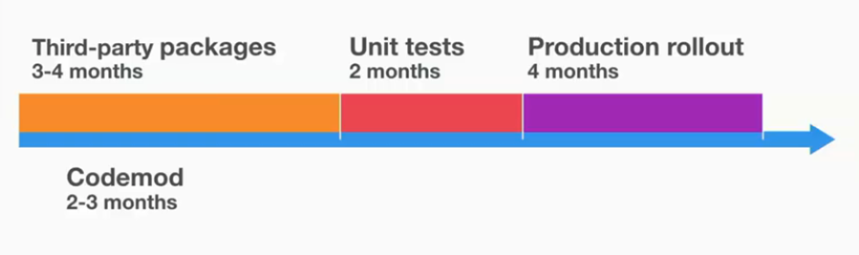
Case Study: Instagram (Python 2 to Python 3)
Migration was done over 10 months, all changes merges to Main branch
Working Rule: No Python 3, no new package
Examples of Refactoring:
Differences in unicode, str, bytes. Solved by using helper functions
Iterator differences, such as map. Solved by converting all maps to list in Python 3
Dictionary order is different in different Python versions, which caused differences in the dumped JSON data. Solved by forcing sorted_keys in json.dump function
PyCon 2017 Keynote Talk: https://www.youtube.com/watch?v=66XoCk79kjM
http://euccas.github.io/blog/20170616/how-instagram-moved-to-python-3.html
Notes:
Reasons for migration: -Typing support for dev velocity, -Better performance than Python 2, -Community continues to make Python 3 better and faster Took 10 months. All changes were directly merged to Main branch. Initially infrastructure was extended to support both Python2 and Python3. In the talk, Lisa shared the challenges they faced in the migration process and how did they solved those problems.
Differences in unicode, str, bytes. Solved by using helper functions.
Pickle memcache data format incompatibility in Python 2 and Python 3. Solved by isolating memcaches for Python 2 and Python 3.
Iterator differences, such as map. Solved by converting all maps to list in Python 3.
Dictionary order is different in different Python versions, which caused differences in the dumped JSON data. Solved by forcing sorted_keys in json.dump function.
With Python 3, while CPU instructions per request decreased by 12%, max requests per second (capacity) had 0% increase! Found the root cause in the code of checking memory configuration, and the issue was memory optimization condition was never met in Python 3 as True because of unicode issue. Solved by adding a magical character “b”, just like this:
In Feb 2017, Instagram’s stack completely dropped Python 2 and moved to Python 3 (v3.6).

Slide 31
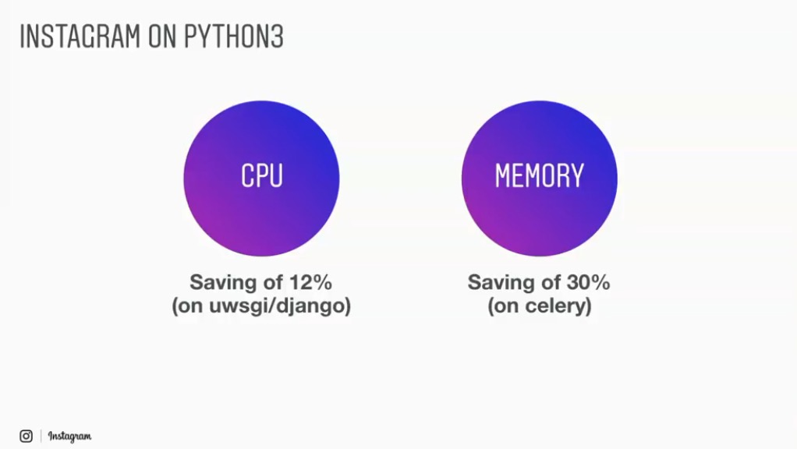
Case Study: Instagram (Python 2 to Python 3)
Feb 2017: Completely dropped Python 2
PyCon 2017 Keynote Talk: https://www.youtube.com/watch?v=66XoCk79kjM
http://euccas.github.io/blog/20170616/how-instagram-moved-to-python-3.html
Notes:
Instagram’s python 3 migration took 10 months and was completed in Feb 2017. It has resulted in a lot of saving in CPU usage (12%) and memory utilization (30%).

Slide 32

Retire Technical Debt at Leisure
Set aside time to pay off technical debt:
Google has (had?) “20%-time” for tasks such as this.
A new initiative can take on some technical debt:
Refactoring at the start of a project.
Don’t keep on putting off!
When a crisis hits, it’s too late;
Hasty fixes to unmaintainable code multiplies problems;
Eventually mounting technical debt can bury the team.

Slide 33
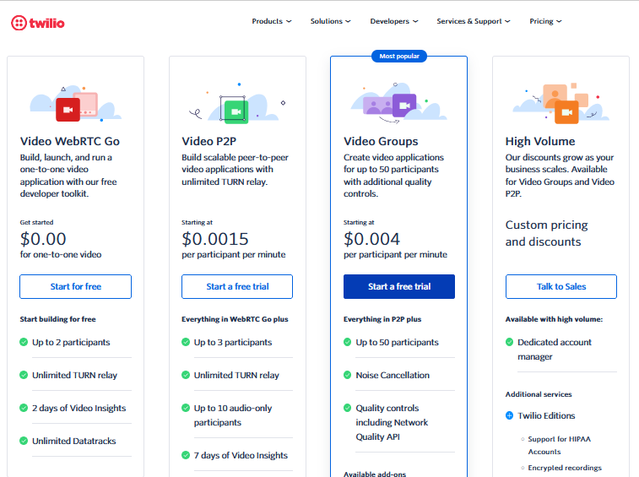
Twilio Programmable Video vs Amazon Chime Video conferencing service
What if we need more than 50 people in a town?
Discuss strategies for determining if/when/how to migrate to Amazon’s Chime Video service?

Slide 34
Review: Learning Objectives for this Lesson
You should now be able to:
Define “refactoring” and give examples.
Explain how refactoring fits into an agile development process
Define “technical debt”
Suggest when it may be appropriate to accrue technical debt and when it may be appropriate to retire it.
Notes:
Activity: Individually, Identify 5 candidates for Refactoring in your project code so far. Then come together as a group to share and discuss. Keep that list with you to work on during the project.

